Slide 1
Parking Violations in Washington D.C. in 2017
Annabelle, Marthenya, Laura, Kathy

Slide 2
Motivations and Summary
Washington DC issued 1,404,052 parking tickets in 2017 bringing in more than 30 million dollars of revenue. This study aims to better understand this revenue stream by:
Exploration of which parking violations are issued in DC
Exploration of DC’s relationship to surrounding areas
Basic behavioral study of when and where violations occur in the city
Sentiment of the reasons tickets are issued

Slide 3
Questions
What are some of the common types of violations in DC and how much revenue does these violations produce?
What are the areas in DC with the most parking violations?
Are local drivers more or less likely to receive parking violations in DC compared to drivers from out of state?
Does the number and frequency of violations change depending on the time of the year? Day of the week? The season?
Does weather and temperature affect the frequency and number of parking violations?
(Just for fun) What are some weird parking violations out there?

Slide 4
Parking Violations in Washington D.C. in 2017
Kathy

Slide 5
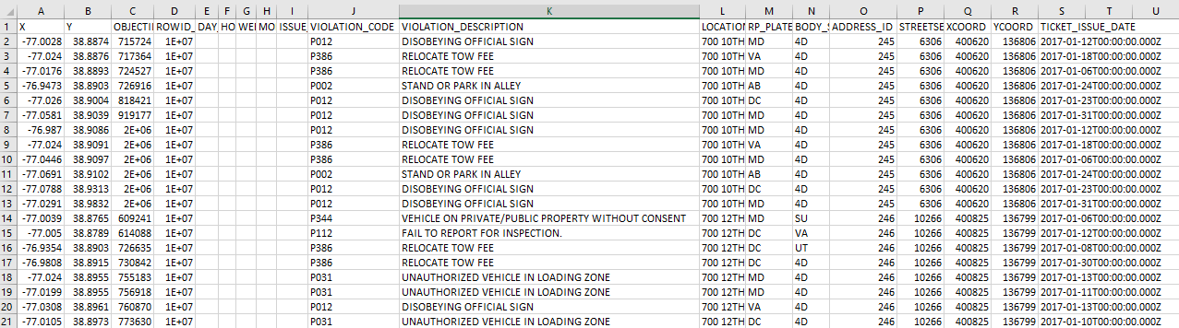
Data
2017 Parking Violation Data from Open Data DC (opendata.dc.gov)
12 CSV files (one for each month of the year)
Total of 1,404,052 rows
X, Y, Violation Code and Description, State License Plate, Address ID, Ticket Issue Date

Slide 6
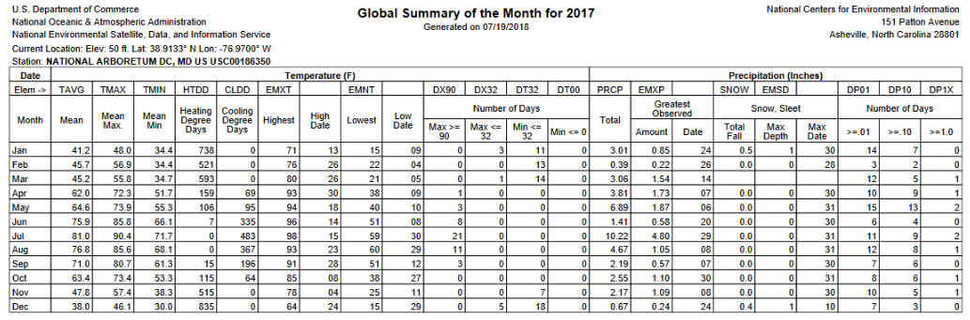
Data
Global Summary of Month (GSOM) for 2017 data for the National Arboretum in DC from the National Centers for Environmental Information API

Slide 7
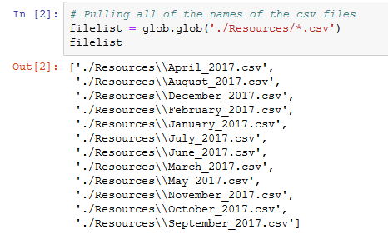
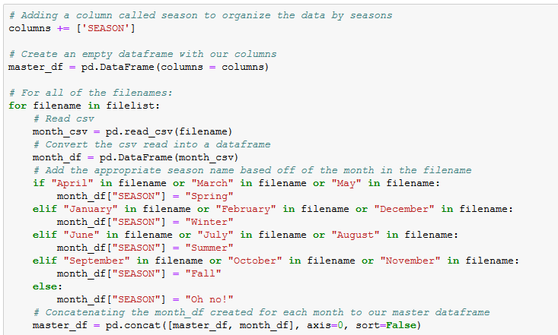
Data Cleanup and Exploration
Read all CSV files and concatenate them together, adding a “SEASON” column

Slide 8
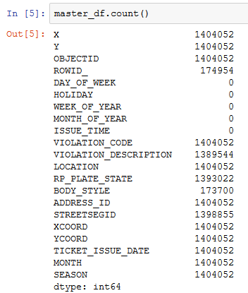
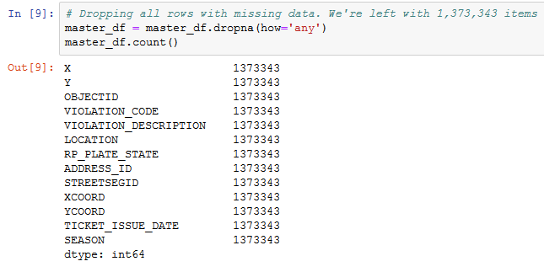
Data Cleanup and Exploration
Deleted empty columns and rows with missing values

Slide 9
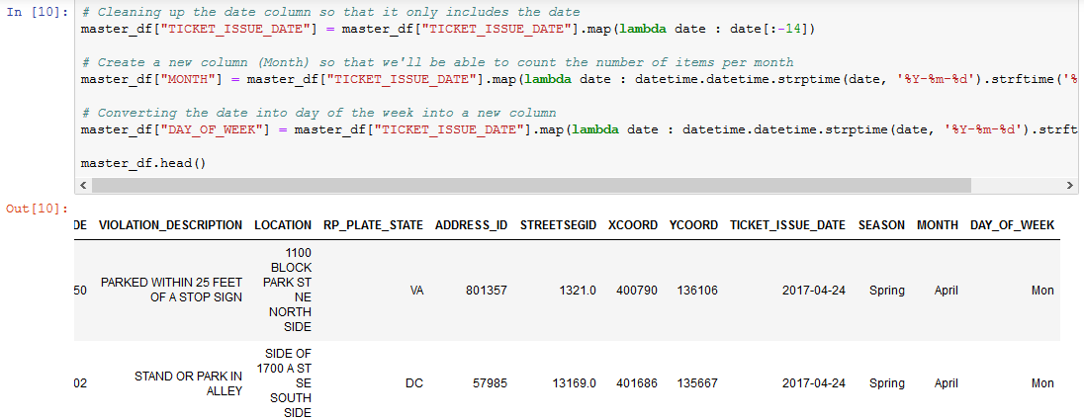
Data Cleanup and Exploration
Clean up date column and created “MONTH” and “DAY_OF_WEEK” column based on the resulting date

Slide 10
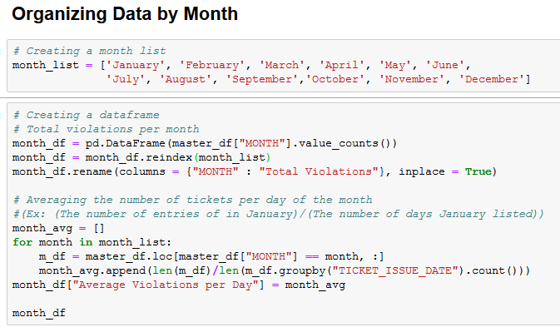
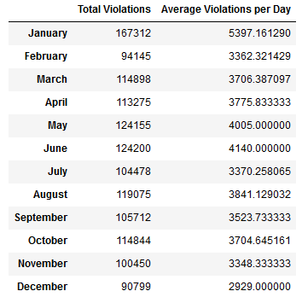
Data Analysis
Sorted violations by month, season and day of the week
Calculated the average number of violations per day per month, season and day of the week

Slide 11
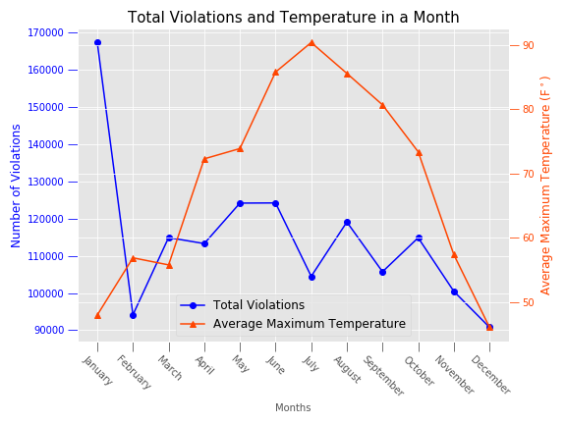
Data Analysis
No apparent relationship between parking violations and temperature
Violations peak in January and dip in December

Slide 12
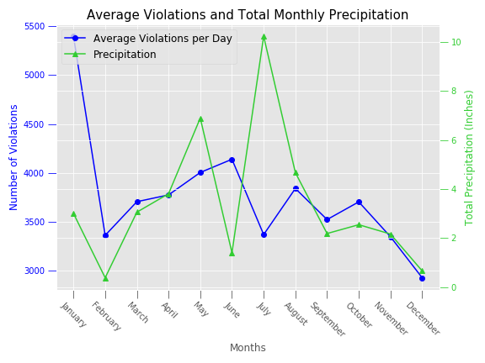
Data Analysis
No direct trend between precipitation and violations
Precipitation peaked in July, which may be related to the dip in violations

Slide 13
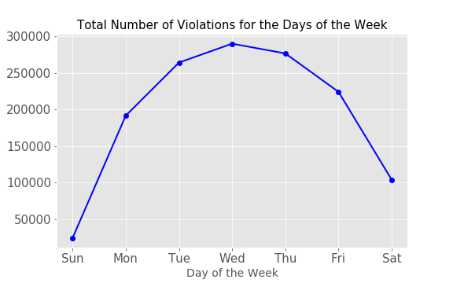
Data Analysis
Violations are lowest during the weekend and peak on Wednesdays
There is typically less restricted parking during the weekends, especially Sundays.

Slide 14
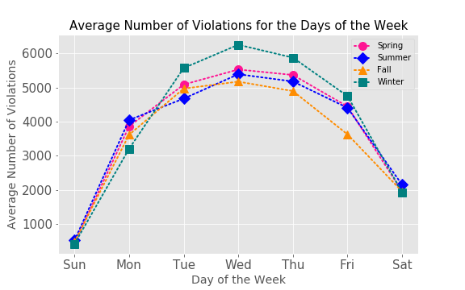
Data Analysis
Slightly higher average violations for middle of the week Winter

Slide 15
Data Analysis
Seasonal and month data may not be reliable as it is only based on single year
For the future: look at multiple years to have multiple sets of months and seasons
Only some of the CSVs have timestamps: did not look at differences in violations across the time of day

Slide 16
Parking Violations in Washington D.C. in 2017
Laura

Slide 17
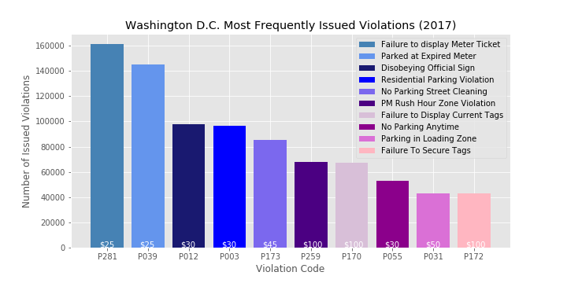
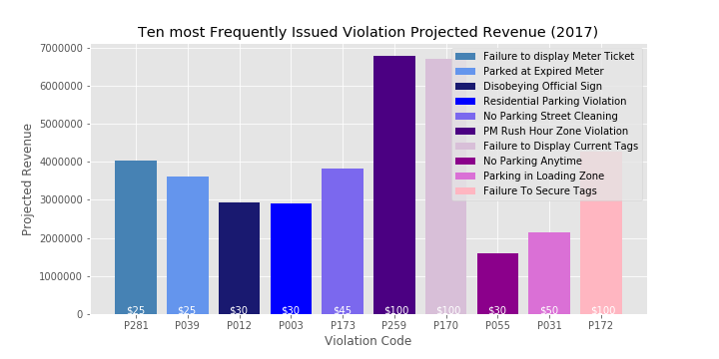
Top Ten Most Frequent Tickets DC 2017
1,404,052 Parking tickets issued in Washington, DC, in 2017
61% tickets issued are in the top ten most frequent tickets
Most frequent violation:
”Failure to Display Meter Ticket”
Projected revenue (2017): $38,812,030
Highest grossing:
”PM Rush Hour Violation,” $6,780,200

Slide 18
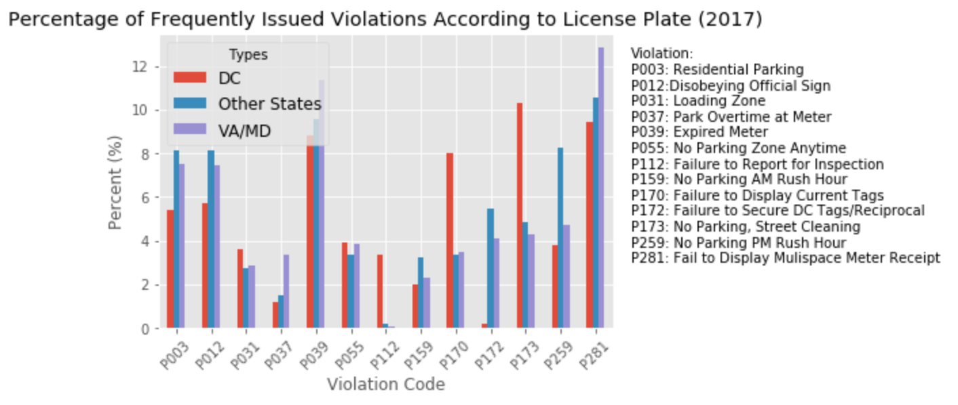
Uneven scores:
DC, P173, 5.77 percentage points higher
Other States, P259, 3.98 percentage points higher
VA/MD, P281, 2.86 percentage points higher
The most evenly distributed violations:
P055, average percentage difference of .42%
P031, average percentage difference of .76%

Slide 19
Parking Violations in Washington D.C. in 2017
Marthenya

Slide 20
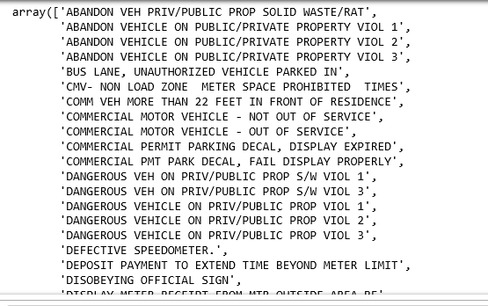
Identify Unique Violations
Create array of unique Violation Descriptions

Slide 21
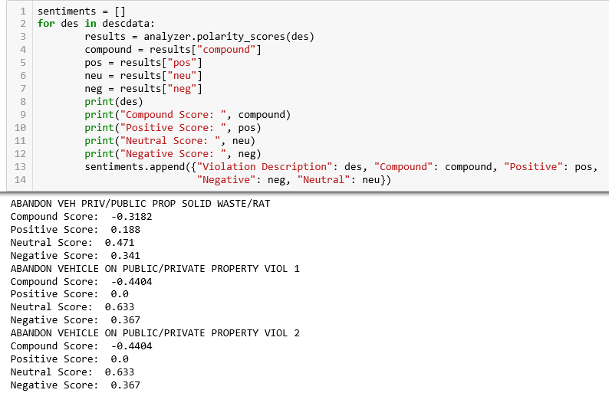
Sentiment
Perform Sentiment Analysis

Slide 22
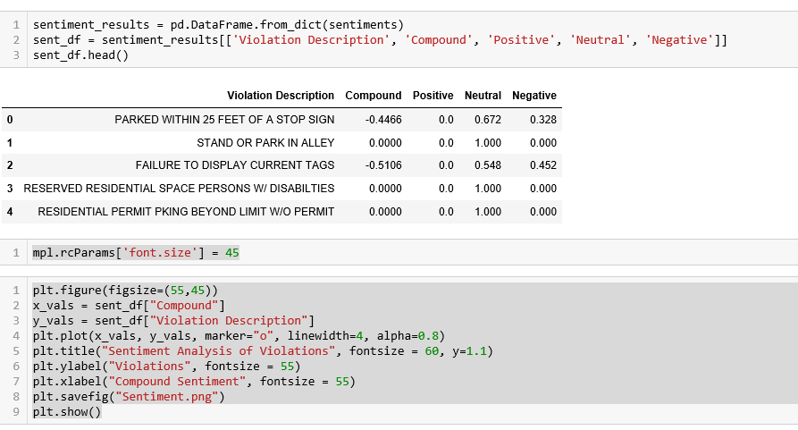
Sentiment Dataframe
Placed sentiment results in dataframe and performed plot

Slide 23
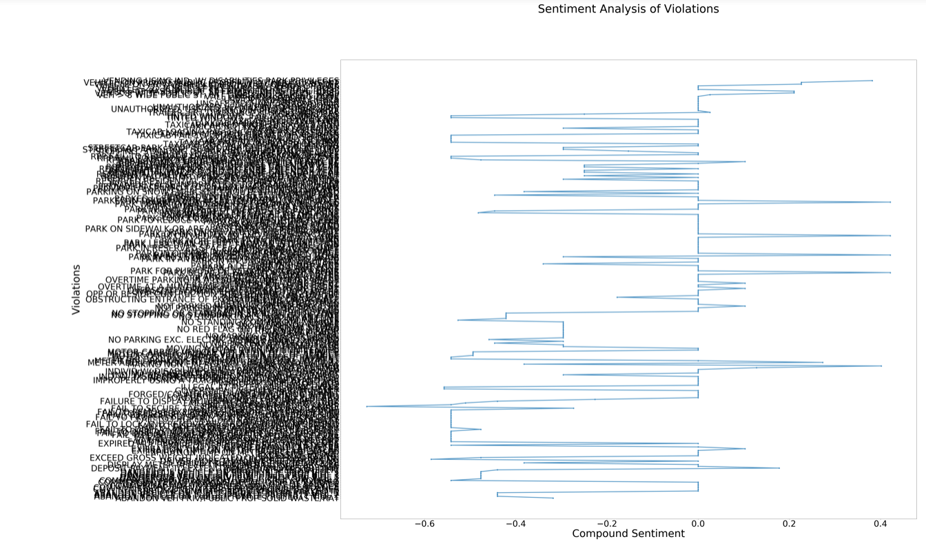
Sentiment Plot

Slide 24
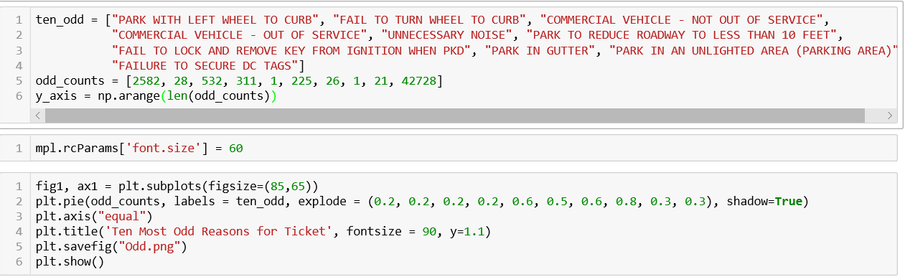
Oddest Reasons for Tickets
Created lists for odd violations and number of tickets. Performed plot

Slide 25
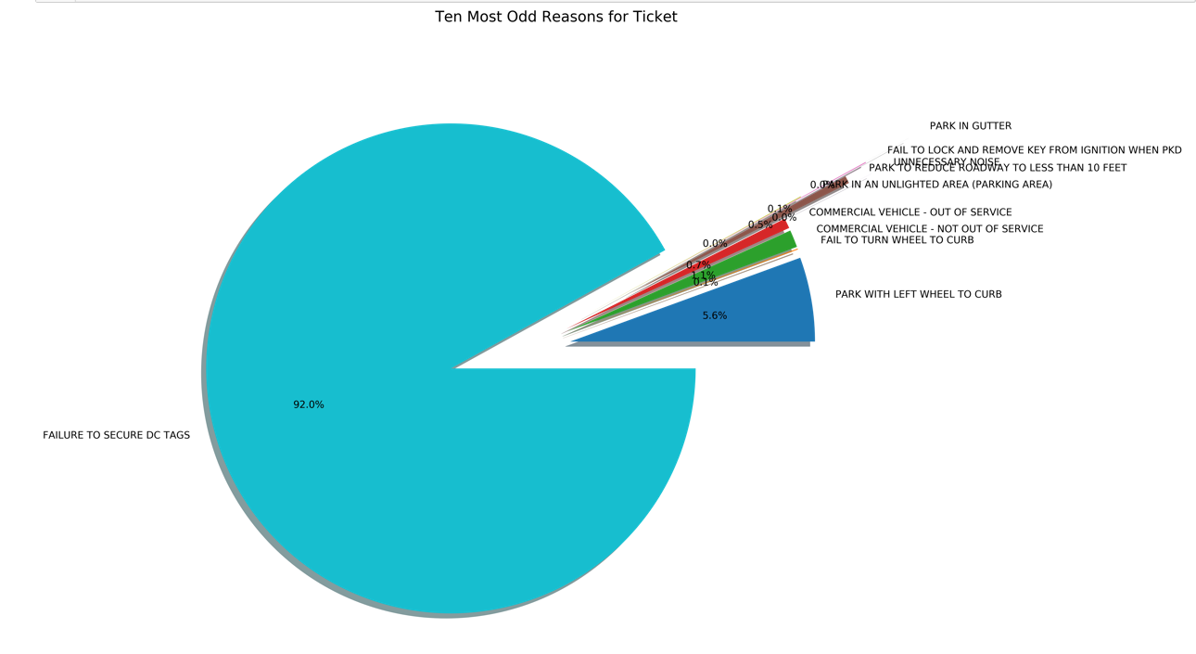
Odd Tickets Plot

Slide 26
Parking Violations in Washington D.C. in 2017
Annabelle

Slide 27
Mapping ticket locations
What are the most densely ticketed areas in DC?.
To display the ticket locations on a map, we made a copy of the master dataframe, keeping only the Latitude and Longitude coordinate data.
We used Folium to plot the ticket locations onto a map, and to subsequently cluster those ticketed areas.

Slide 28
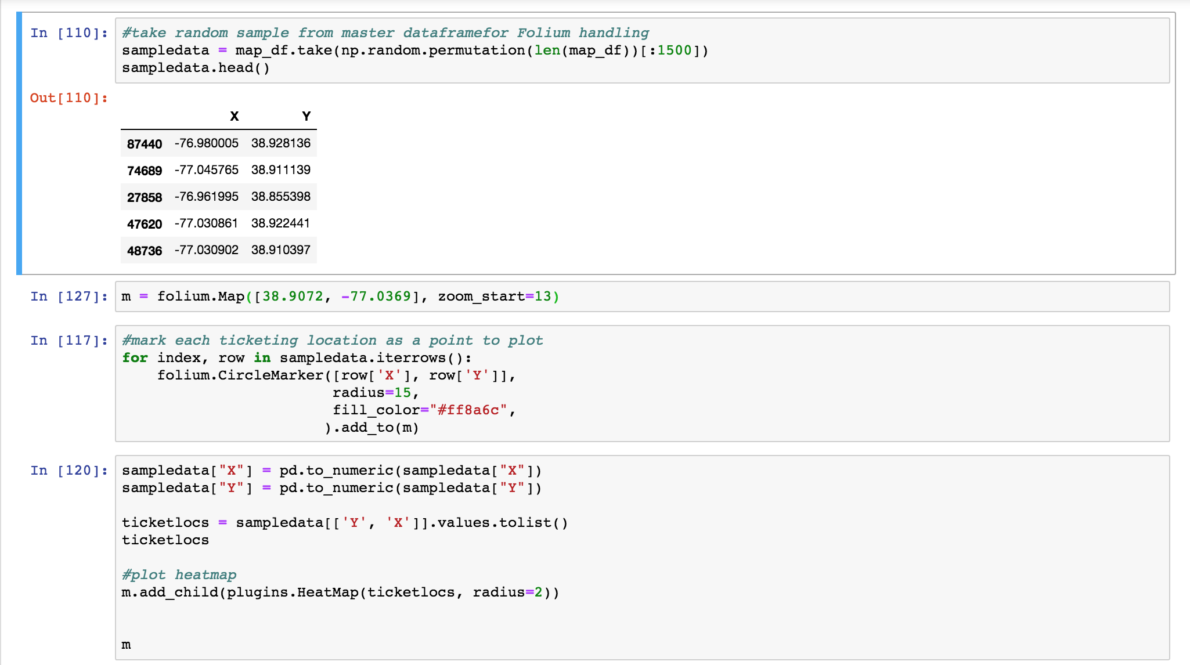

Slide 29
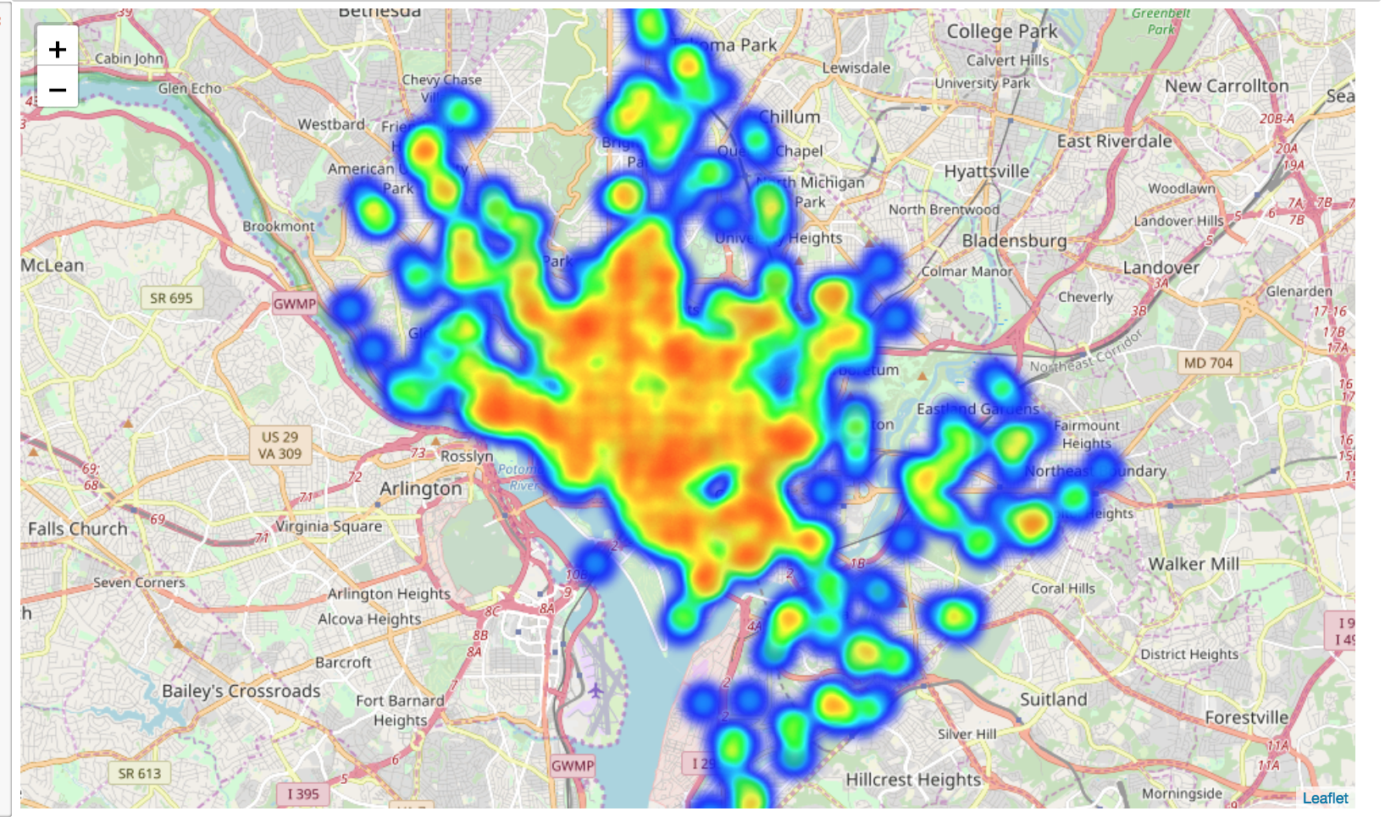

Slide 30
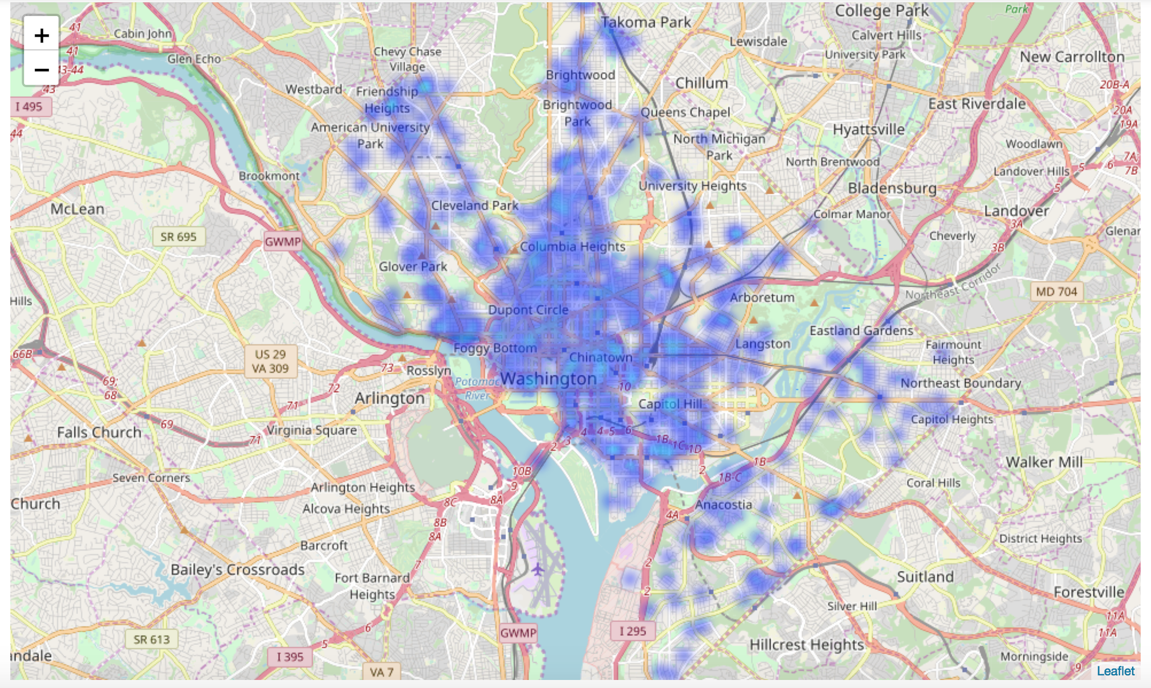

Slide 31
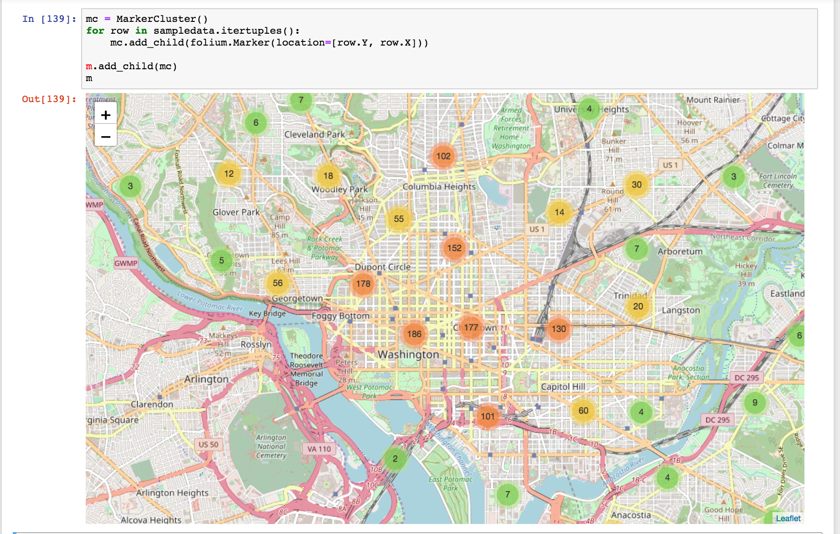

Slide 32
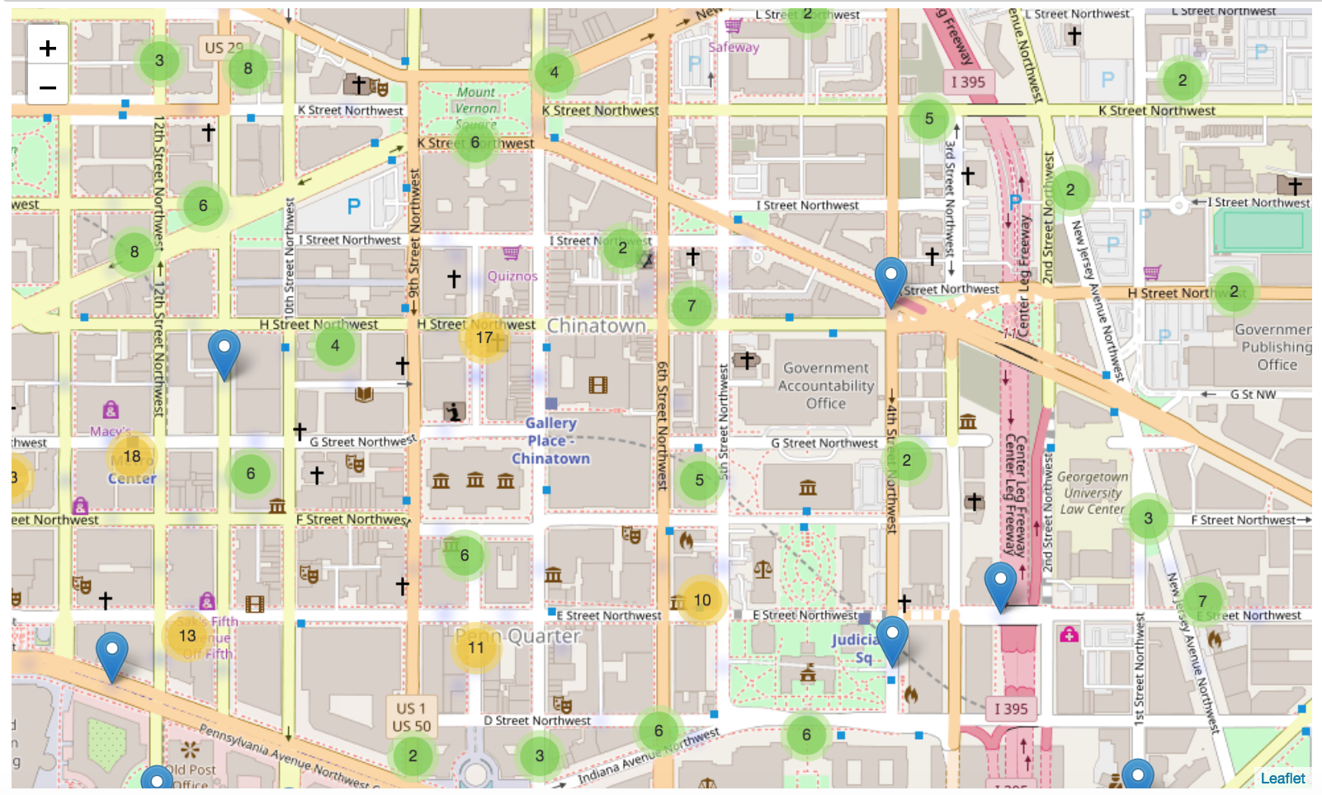

Slide 33
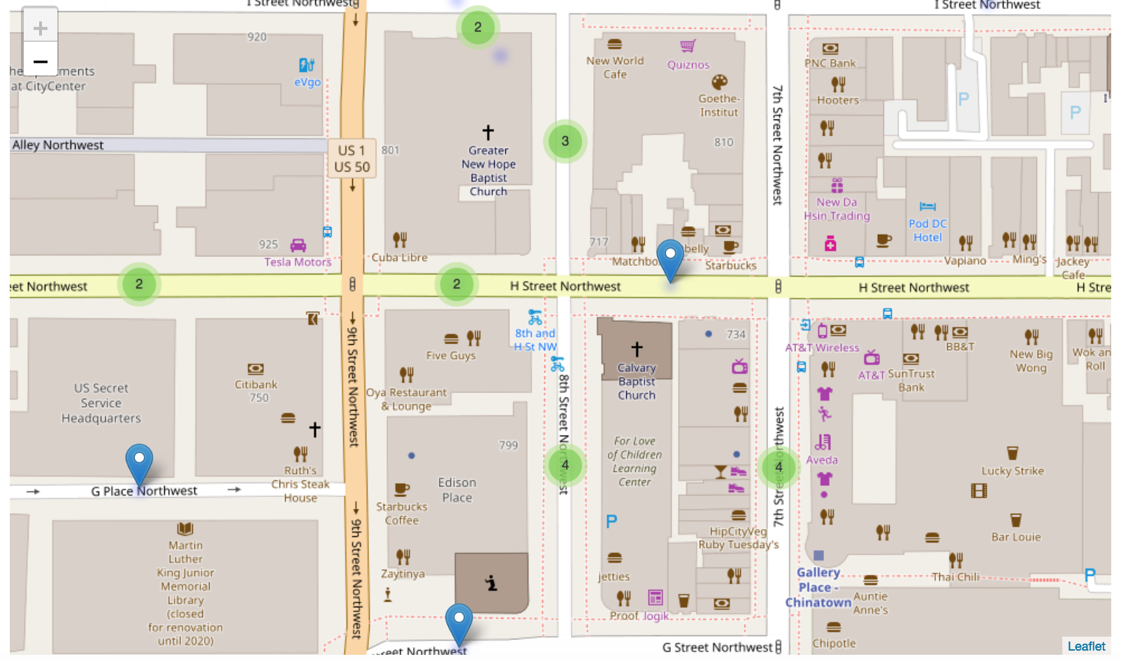

Slide 34
Limitations faced while mapping
The massive size of our dataset meant a very long wait time, and no successful full mapping result.
We planned on proportionally scaling down our dataset, but some of Folium’s potential limitations led us to use a random sample instead.
Questions we would have liked to have been able to answer:
1. What were the most prevalent neighborhoods for ticketing in 2017?
2. What quadrants issued the most parking validations in 2017?
3. Dig deeper into how a location’s ticketing volume might change by season.
4. How DC’s ticketing rate stacks up against the rest of the country

Slide 35
Parking Violations in Washington D.C. in 2017
Laura

Slide 36
Conclusion
In 2017 there were 215 unique violation issued. There were obvious reasons for citations such as the most frequently issued ‘Failure to Display Meter,’ cited 161,265 times and not so obvious reasons such as ‘Failure to lock and remove key from the ignition,’ cited once.
Parking tickets are a vital part of Washington DC bringing order, safety and revenue for the city, with the highest ticketed reason being failure to display paid meter receipt.
Also, for residents, commuters and tourist it would be to their advantage to read this study and understand the system to avoid situations such as being ticketed for parking overnight with non-DC tags.
The datasets allowed us to find trends in weather, seasons , residency and days. Wednesdays and January are the highest ticketed days and month.
The overall sentiment of ticketed Violation Descriptions is negative.

